Slide 1
Frontend for end-users
Jeroen Claassens
Notes:
Good morning everyone. In the workshop today I will introduce you to the world of frontend development.

Slide 2

Who am I
Jeroen Claassens | Experienced Software Engineer +31 (0)6 5112 7382
j.claassens@cgi.com
Notes:
First a bit about myself. Hi! My name is Jeroen Claassens. I’ve been a developer for about 10 years now

Slide 3
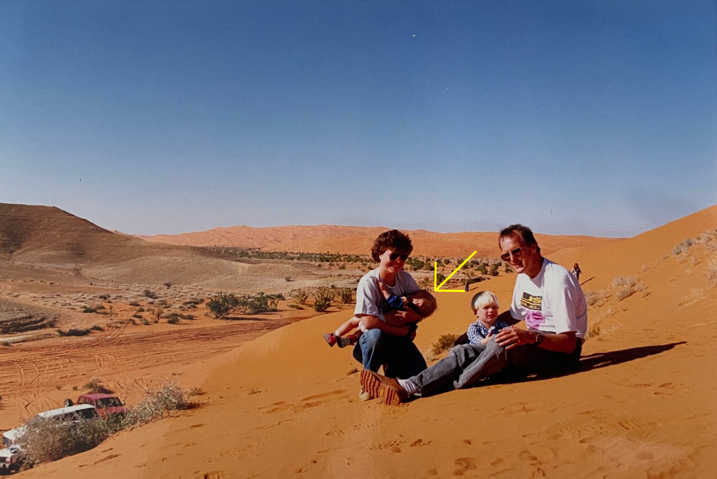
Who am I?
I Live in Delft
I’m a huge fantasy nerd (talk to me about Lord of The Rings, Harry Potter, Dungeons & Dragons, and more)
I do a lot of open source development in my free time.
I love building PCs and working with tech.
Notes:
I was born in the deserts of Saudi Arabia

Slide 4
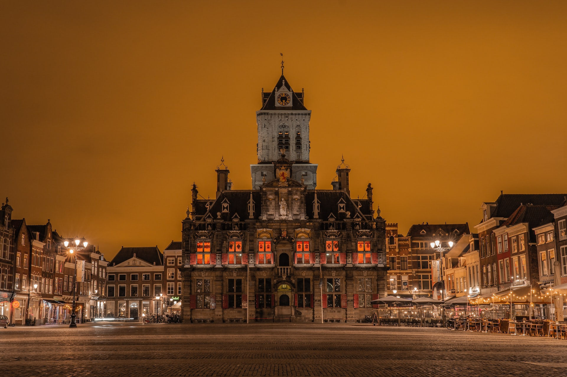
Who am I?
I Live in Delft
I’m a huge fantasy nerd (talk to me about Lord of The Rings, Harry Potter, Dungeons & Dragons, and more)
I do a lot of open source development in my free time.
I love building PCs and working with tech.
Notes:
but right now I live in the beautiful city of Delft

Slide 5
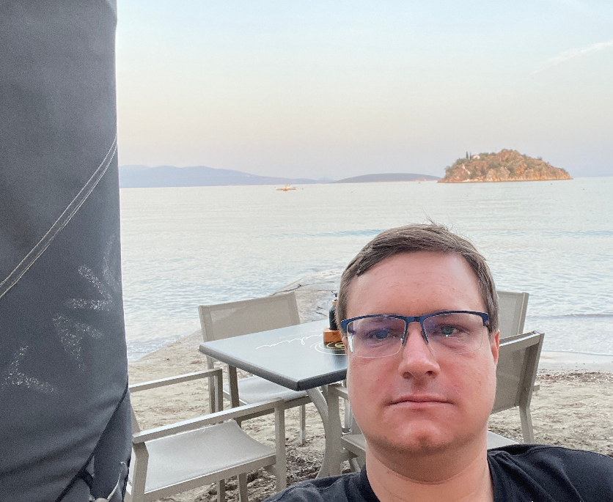

Who am I?
I’m a huge fantasy nerd (talk to me about Lord of The Rings, Harry Potter, Dungeons & Dragons, and more)
My free time is primarily spent with open source development and (table-top) gaming.
I love learning about and working with all tech.
Notes:
In my spare time I’m a huge lover of all kinds of fantasy. My free time I primarily spent workin on various open source projects that I maintain and I also game a lot. In general I am also a big fan of all things tech.

Slide 6


Who am I?
Jeroen Claassens (Experienced Software Engineer)
Started at CGI in March 2019
Rijkswaterstaat (1,5 years)
Full-stack TypeScript & Java developer
Primarily worked the new Asset Management frontend
ProRail (2,5 years)
Full-stack TypeScript & Java developer
Worked on improving the front- and backend of the GMS/WLIS project
Back at Rijkswaterstaat (current)
Java developer & ops engineer
Back on the project of 2019, of which the landscape has greatly changed
Notes:
I started working for CGI in 2019. First I worked for the Rijkswaterstaat unit where I was primarily a frontend development but also dabbled a bit in the Backend, CI/CD, Cloud and Ops processes of the project. After this I moved to the ProRail unit where I worked as a full-stack frontend and backend developer, and right now I have moved back to Rijkswaterstaat and I am now working on the same project where I started at 2019 but primarily as a backend developer while also doing ops.

Slide 7
General workshop information
The workshop will have both and morning and afternoon program
I encourage the taking of notes, because we will go through a lot of information
These slides will be sent to all participants after the course. The slide notes have a rough outline of what I have told you.
Notes:
First I would like to address some general notes for today. Today we will have both a morning and an afternoon program. Furthermore this is the first time that we are including a frontend fundamentals workshop in the graduate class, so in advance I’m apologize for any mistakes haha. Because of this I can also not say entirely for sure at what time we will be finished, but at the latest we will stop at 4 30.
Next I encourage the taking of notes. We will go through a lot of information and there will be a lot of information to process. Notes can help you do so.
Lastly these slides will be sent to all participants after the course. I have included the bulk of what I will tell you in the speaker notes of each slide so you can review most of the workshops.

Slide 8
Has everyone managed to install NodeJS?
Notes:
Before we start I would like to check if everyone was able to complete their homework, installing NodeJS.
For those that have faced issued, I have reserved a about 10 minutes before the lunch to aid you.

Slide 9
Agenda
A brief introduction to frontend and its importance
HTML / CSS / JavaScript
Lunch 🥪🍽️
Frontend development in the field
Notes:
Now lets go over the agenda for today. To start I will give you a brief introduction to what frontend is, how we define frontend for the scope of this workshop, and why frontend should be considered as an important part of the services delivered by CGI. After this I will give you an introduction to HTML, CSS, and JavaScript which together make up the fundamental building blocks for developing a modern frontend. This should take until about a quarter to twelve after which there will be some time to help anyone who wasn’t able to complete their homework or time for longer questions and then we’ll have lunch until 1 o clock. After the lunch we’ll dive into the frontend development as you might see it being used in the field at CGI projects, this means we’ll start working with Node, looking into libraries like React, and more.

Slide 10
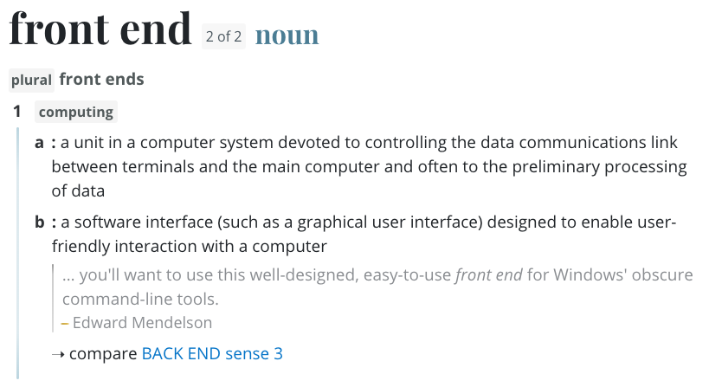
What does “frontend” even mean!?
Notes:
Lets stay by defining the term “frontend”. I like to think that it’s often best to start with a definition from the dictionary. The dictionary defines the frontend as a software interface, such as a graphical user interface, designed to enable user-friendly interaction with a computer. What this means is that for an end-user to use a program, they will always use a frontend of some kind. That frontend can be a program such as Microsoft Word or Notepad, or a website such as Google.

Slide 11
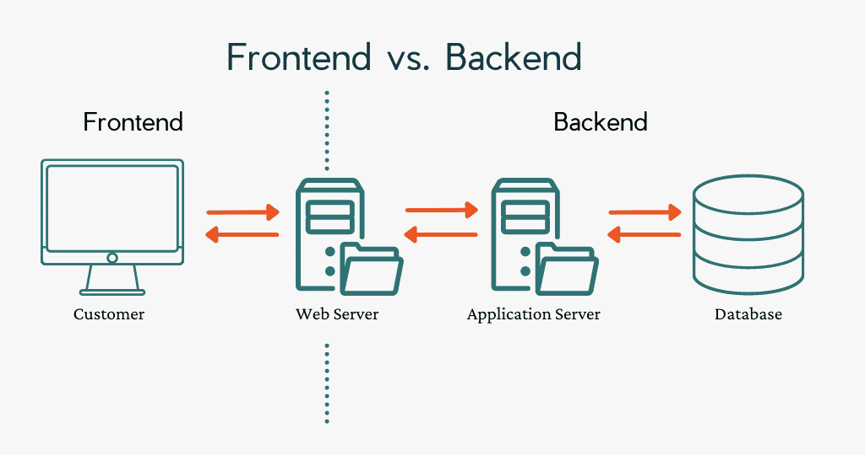
What does “frontend” even mean!?
Notes:
The opposite of a frontend is the backend, which is everything the user does not interact with. Frontend and backend are always coupled in some way, such as through a server.
So as you can probably surmise, frontends are very important because without a frontend the end-user has nothing to interact with.

Slide 12
What is frontend development?
Notes:
So while the definition of frontend can be very broad, normally when we talk about frontend development we’re talking about developing for the web. It is about crafting a beautiful, intuitive and responsive looking application that runs in a web browser and can be used by anyone, anywhere and at any time.

Slide 13



HTML, CSS, and JS (JavaScript)
Notes:
So with that covered lets look at the three programming languages that are used together to create frontends, HTML, CSS and JS, or JavaScript.

Slide 14
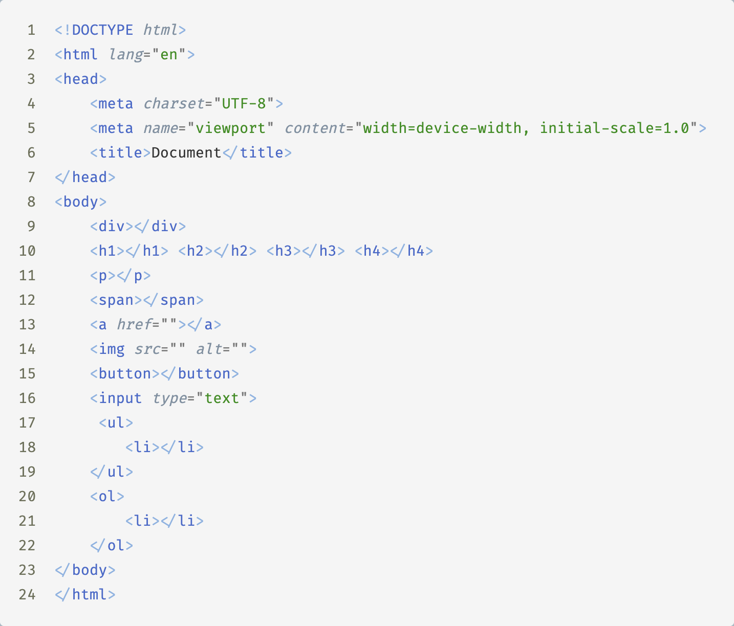
HTML
Structure
Content
Uses elements
Notes:
HTML, short for HyperText Markup Language, is the backbone of web pages. It provides the structure and content for your website. HTML uses a system of elements and tags to define the different parts of a web page, such as headings, paragraphs, images, links, and more. HTML elements are the building blocks that create the structure of your content. There are many many HTML elements these days and in the GitHub repository for this workshop you’ll find a text file called “important links” which has a link to a list of all elements and a description for each.

Slide 15
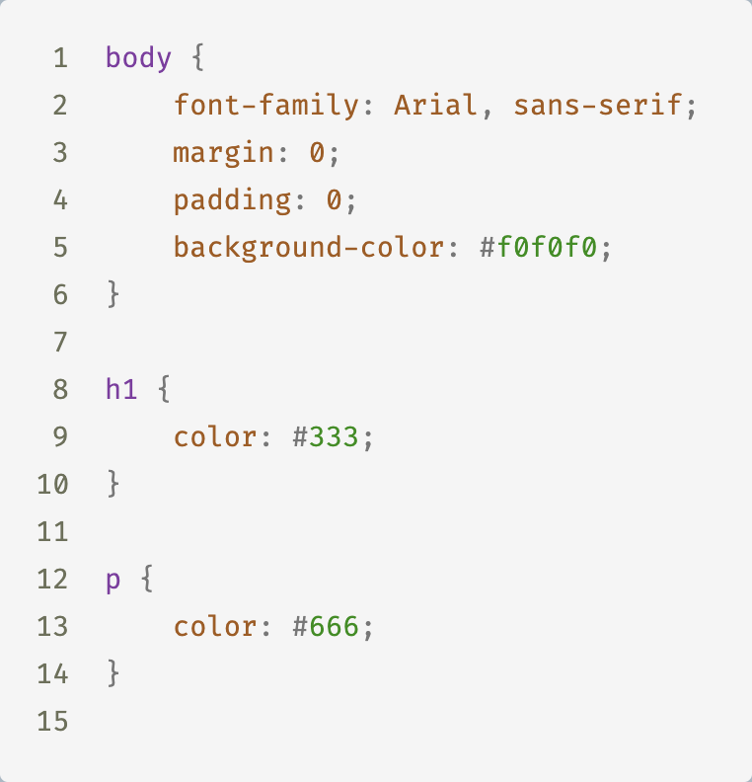
CSS
Layout
Colours
Fonts
Notes:
CSS, short for Cascading Style Sheets, is used to style your HTML elements and make your web page visually appealing. It controls how elements are presented on the screen, including their layout, colours, fonts, and spacing. CSS allows you to create a consistent and visually attractive design for your website.

Slide 16
JS
Layout
Colours
Fonts
Notes:
And lastly, JavaScript. JavaScript is the programming language that enables you to add interactivity and dynamic behaviour to your web pages. With JavaScript, you can create animations, handle user input, update content without reloading the page, and more. It's what makes modern websites feel interactive and engaging.

Slide 17
Demo
Notes:
Now that we’ve covered some basics I would like to give a small demo of a simple web page, and after this demo I will ask you to start on the first exercise.

Slide 18
Exercise 1
Are you allowed to drink webapp
Notes:
As I said I would now like to have you all start with exercise 1. In this exercise your job is to create a very simple web application that asks the user’s age and then tells them if they are allowed to drink or not. You will find the exercise in the GitHub repository for this workshop, along with a README that has more information about the exercise.

Slide 19
Exercise 1 - Demo
Are you allowed to drink webapp
Notes:
Alright now that you’re all finished or nearly finished I would like to give a quick demo of the solution as I had originally designed it.
Explain HTML code with text insert element
Explain HTML input element, highlight the ‘id’ property and the ‘type’ property
Explain the JavaScript
Binding the event
Getting the value
Checking for NaN
Processing true/false
‘let’ vs ‘var’ vs ‘const’

Slide 20
Exercise 2
CSS Styling
Notes:
Alright now that we’re done with that exercise I would like to move on to a different branch, which is the CSS integration with HTML. For this I have prepared another exercise, number 2. The assignment here is to get as close as an approximation to the screenshot of the finished result that you will find in the README. You don’t need to match it exactly, but try to get as close as possible. If you want to know if your solution is close enough, you can ask me to review it.

Slide 21
Exercise 2 - Demo
CSS Styling
Notes:
Once again I would like to give a short demo on the solution as it was prepared
Explain different selectors CSS
Explain property chaining (li.special)
Explain child selectors

